Slide 1
Data Interactive: Data Interactive: Top KPIs to Measure Performance of Data and Analytics Use Cases Published 17 May 2023 ID G00791852 By Kimberly Harris-Ferrante

Slide 2
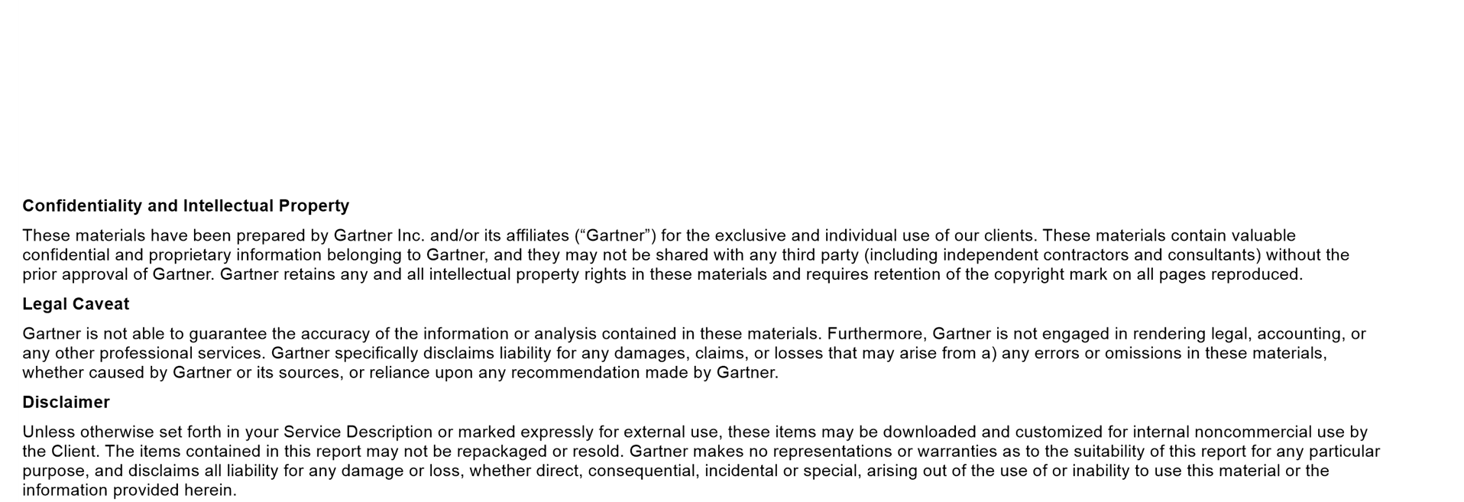

Slide 3
Summary
Use this tool to understand the most frequently deployed KPIs for data and analytics use cases. The data can help executive leaders identify or incorporate top KPIs that peer organizations use to measure business outcomes for the most common data-driven use cases.
Initiatives: Financial Services Technology Modernization and Transformation

Slide 4
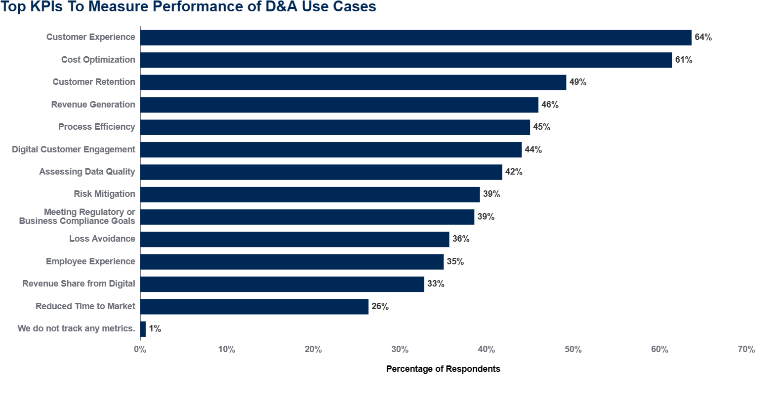
FILTERS: NONE
n = 311 Q. Which of the following KPIs does your organization track to measure the performance of its current Data & Analytics use cases? Select all that apply Source: 2022 Gartner Data and Analytics Digital Transformation Survey

Slide 5
Data Insights
When metrics are defined and connected to business outcomes, as well as organizational goals, tracking KPIs will help guide executive leaders’ business decisions. .The results shown here demonstrate this linkage. Taking the overall survey results, for example, 64% of respondents indicate they track customer experience KPIs to measure their D&A use cases, and 39% of respondents say they track risk mitigation.
For the selected segment (region, industry, respondent role or number of employees), the chart shows the percentage of senior executive leaders who indicate that their organization uses the KPI with current D&A use cases. Respondents were permitted to select multiple responses, so answers are not mutually exclusive.

Slide 6
About This Research
2022 Gartner Data and Analytics for Digital Transformation Survey: This survey sought to provide industry-level insight and to find out how organizations use data and analytics and how they relate to digital success. The research was conducted online from 2 September through 13 October 2022. In total, 311 respondents were interviewed across six industries — banking, insurance, healthcare, manufacturing, telecom and transportation. Respondents were required to be primary decision makers or have a high level of influence on their organizations’ or business units’ data and analytics investments. Disclaimer: The results of this survey do not represent global findings or the market as a whole, but reflect the sentiments of the respondents and companies surveyed.

Slide 7
Recommended by the Authors
5 Data and Analytics KPIs Every Executive Should Track
5 Steps to Build Your Data Strategy for Advanced Analytics
How to Optimize Enterprise Value From Data and Analytics

